Slide 1
Forensics Labs Tools
Dr. Iftikhar Alam

Slide 2
CONTENTS:-
Cyber Crime & Evidence
Rules Of Handling Evidence
Top 10 Location For Evidence
Computer Forensics Methodology
Applications of Computer Forensics
Who Uses Computer Forensics
Skills Requirements for Computer Forensics

Slide 3
CHARECTERISTICS OF COMPUTER FORENSICS
IDENTIFYING
PRESERVING
ANALYZING
PRESENTING

Slide 4
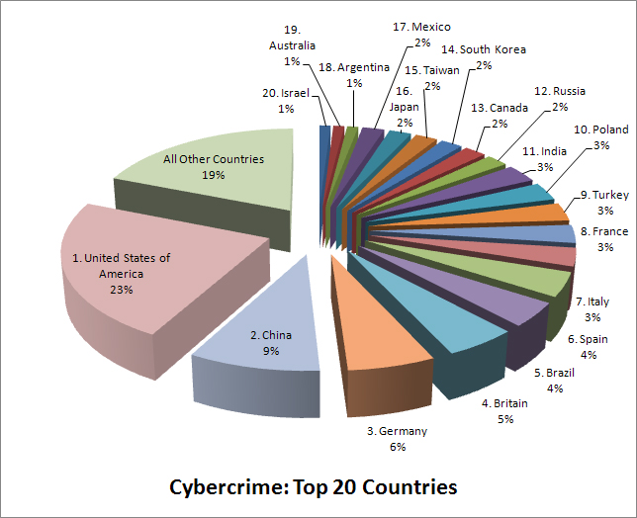
Cybercrime: Top 20 Countries

Slide 5
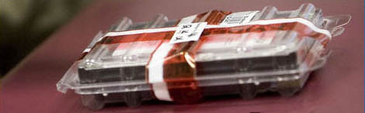
Evidence
An item does not become officially a piece of evidence until a court admits it.
Much of forensics practice concerns how to collect, preserve and analyze these items without compromising their potential to be admitted as evidence in a court of law.

Slide 6
DIGITAL EVIDENCE
“Any data that is recorded or preserved on any medium in or by a computer system or other similar device, that can be read or understand by a person or a computer system or other similar device. It includes a display, print out or other output of that data.”

Slide 7
TYPES OF DIGITAL EVIDENCE
1) PERSISTANT DATA
Meaning data that remains intact when the computer is turned off. E.g. hard drives, disk drives and removable storage devices (such as USB drives or flash drives).
2) VOLATILE DATA,
Meaning data that would be lost if the computer is turned off. E.g. deleted files, computer history, the computer's registry, temporary files and web browsing history.

Slide 8
5 RULES OF EVIDENCES
Admissible
Must be able to be used in court or elsewhere.
Authentic
Evidence relates to incident in relevant way.
Complete (no tunnel vision)
Exculpatory evidence for alternative suspects.
Reliable
No question about authenticity & veracity.
Believable
Clear, easy to understand, and believable by a jury.

Slide 9
TOP 10 LOCATION FOR EVIDENCE
Internet History Files
Temporary Internet Files
Slack/Unallocated Space
Buddy lists, personal chat room records, others saved areas
News groups/club lists/posting
Settings, folder structure, file names
File Storage Dates
Software/Hardware added
File Sharing ability
E-mails

Slide 10
APPLICATIONS :-
FINANCIAL FRAUD DETECTION
CRIMINAL PROSECUTION
CIVIL LITIGATION
“CORPORATE SECURITY POLICY AND VIOLATIONS”

Slide 11
Who Uses Computer Forensics?
Criminal Prosecutors
Rely on evidence obtained from a computer to prosecute suspects and use as evidence.
Civil Litigations
Personal and business data discovered on a computer can be used in fraud, harassment, or discrimination cases.
Private Corporations
Obtained evidence from employee computers can be used as evidence in harassment, fraud, and embezzlement cases.

Slide 12
Who Uses Computer Forensics? (cont..)
Law Enforcement Officials
Rely on computer forensics to backup search warrants and post-seizure handling.
Individual/Private Citizens
Obtain the services of professional computer forensic specialists to support claims of harassment, abuse, or wrongful termination from employment.

Slide 13
Skills Required For Computer Forensics Application
Programming or computer-related experience
Broad understanding of operating systems and applications
Strong analytical skills
Strong computer science fundamentals
Strong system administrative skills
Knowledge of the latest intruder tools
Knowledge of cryptography and steganography
Strong understanding of the rules of evidence and evidence handling
Ability to be an expert witness in a court of law

Slide 14
Software for images
Mini partition wizards
Norton Ghost
Rufus

Slide 15
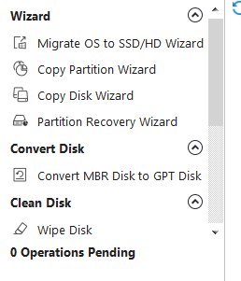
Mini partition tool

Slide 16

Cont…

Slide 17
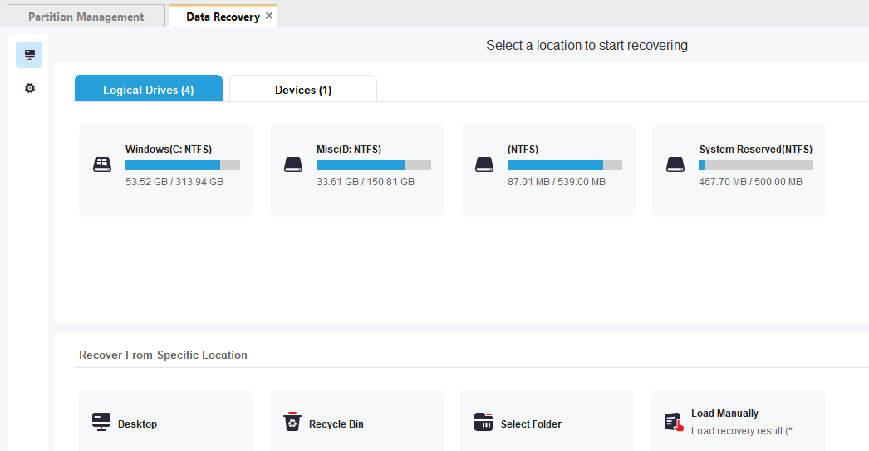
Cont…

Slide 18
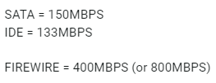
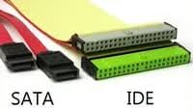
Hardware tools
Disk (IDE, SATA, firewire)
Integrated Drive Electronics (IDE)
Serial Advanced Technology Attachment (SATA)

Slide 19
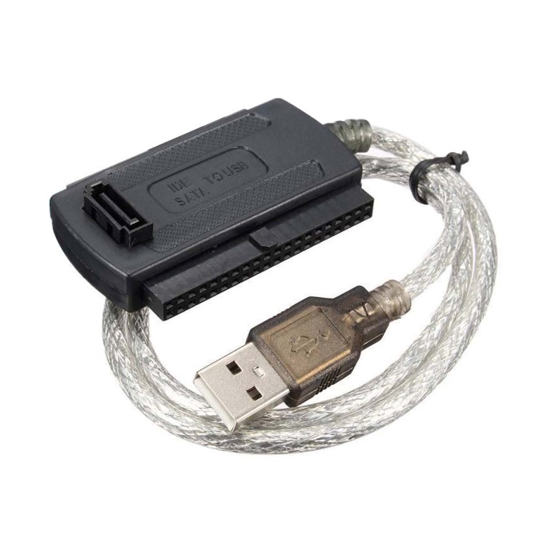
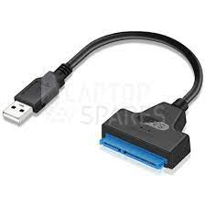
Cont…

Slide 20
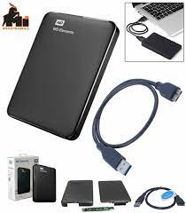
For backups
External hard drives

Slide 21
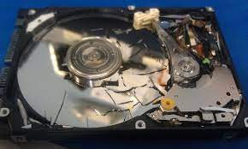
Hard disk media

Slide 22
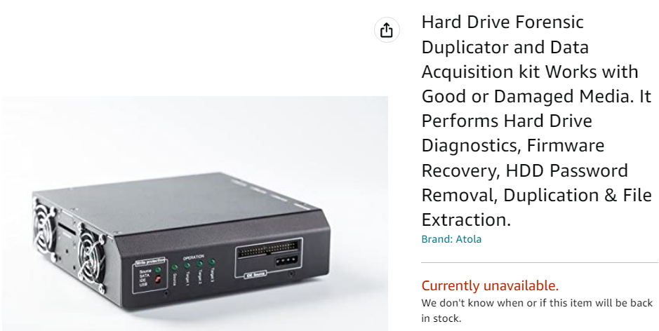
Cont…

Slide 23
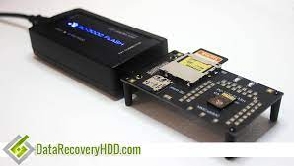
Memory cards

Slide 24
Software for mobile recovery
https://www.tenorshare.net/android-recovery/best-free-android-data-recovery.html?gclid=Cj0KCQiAt66eBhCnARIsAKf3ZNGzbkqpVsHyzvCJFX9QVKK6eyA-ucJPDlk5qTUvoDebfu4ZQINHciYaAqXyEALw_wcB

Slide 25
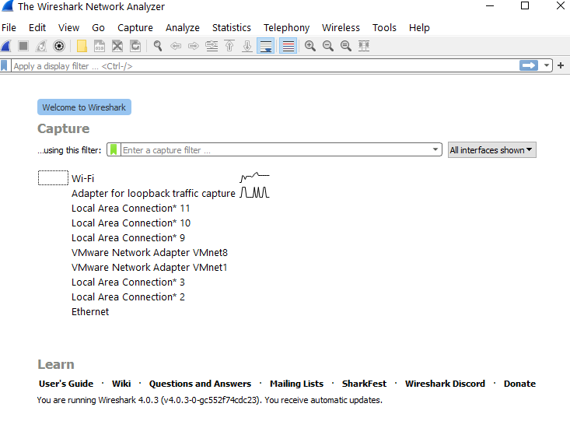
Network forensics

Slide 26

`

